Slide 1




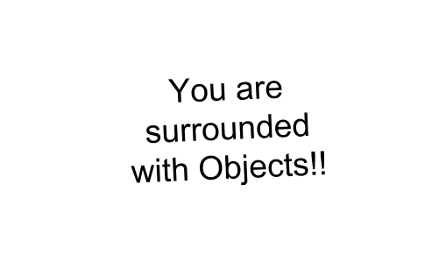





Python Object Oriented Programming
Ms Smriti Sharma

Slide 2
OOP
Object-oriented programming (OOP) involves programming using objects. An object represents an entity in the real-world that can be distinctly identified.
An object consists of identity, state, and behavior.
Identity: It gives a unique name to an object.
State: It reflects the properties of an object.
Behavior: It reflects the response of an object with other objects.

Slide 3
Characteristics of OOPs
OOPs uses a bottom-up approach.
The program is divided into objects.
OOPs uses access modifiers.
OOPs is more secure than procedural languages.
Objects can move freely within member functions.

Slide 4




Classes
Class is a template/blue-print for real-world entities
Properties
Behavior
Color
Cost
Battery Life
Make Calls
Watch Videos
Play Games

Slide 5


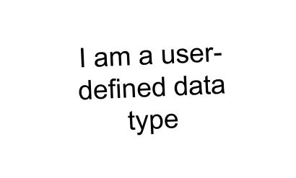




Class in Python
Class is a user-defined data-type
int
float
bool
str
Mobile

Slide 6



Attributes and Methods
color
Attributes are defined within a class and outside any method. Attributes define the characteristics of any object.
Attributes
cost
Play Game
Methods
Methods are functions defined inside a class. They are invoked by objects to perform actions on other objects.
Make Call

Slide 7





Objects
Objects are specific instances of a class
Apple
Motorola
Samsung

Slide 8



Objects in Python
Specific instances of Mobile data type
Apple
Motorola
Samsung
a = 10
b = 20
c = 30
Specific instances of integer data type

Slide 9

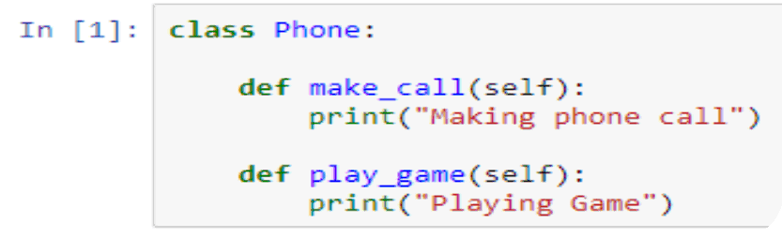


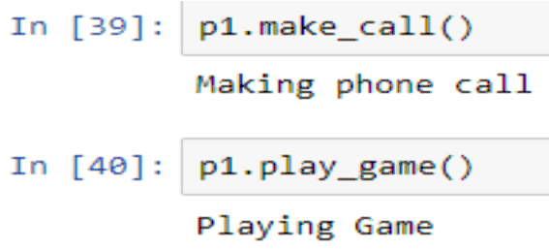
Creating the first Class
Creating the ‘Phone’ class
Instantiating the ‘p1’ object
Invoking methods through object

Slide 10

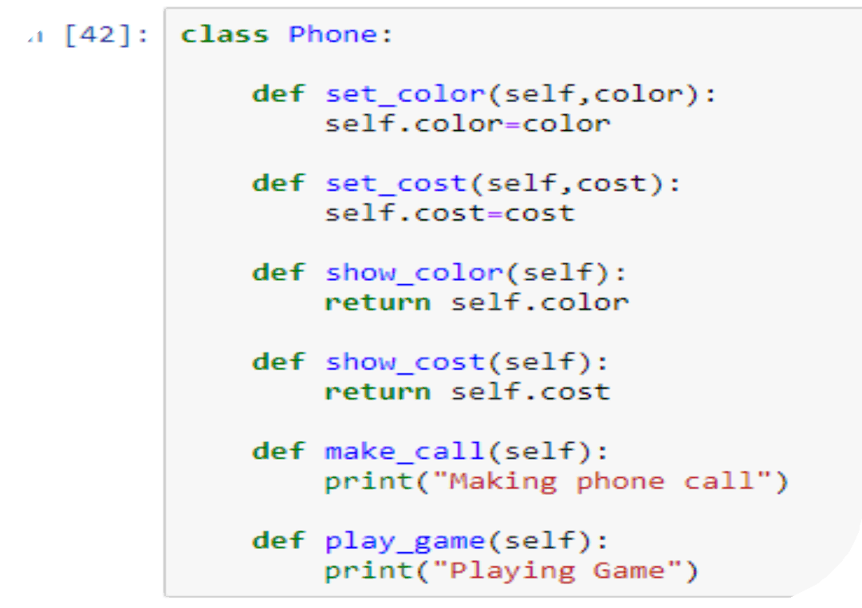
Adding parameters to the class
Setting and Returning the attribute values

Slide 11

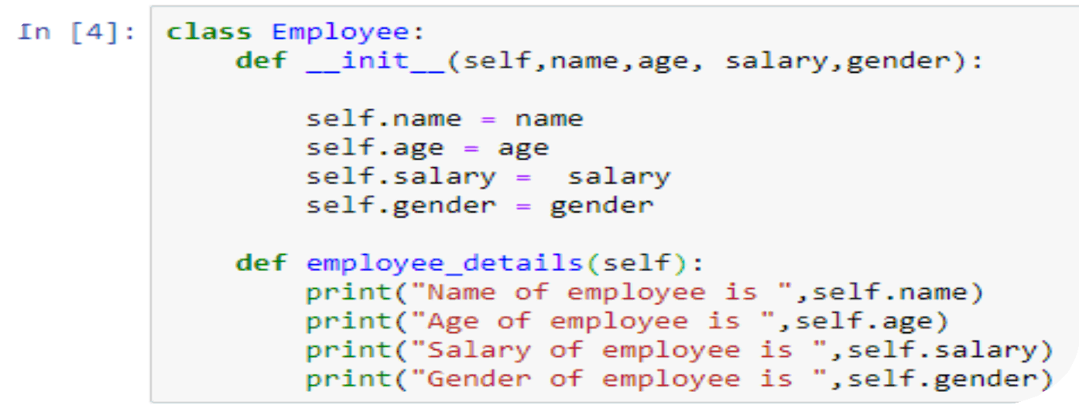
Creating a class with Constructor
init method acts as the constructor
__init__ is a method that is automatically called when memory is allocated to a new object.
For invoking in build parameter with object , self is used .

Slide 12

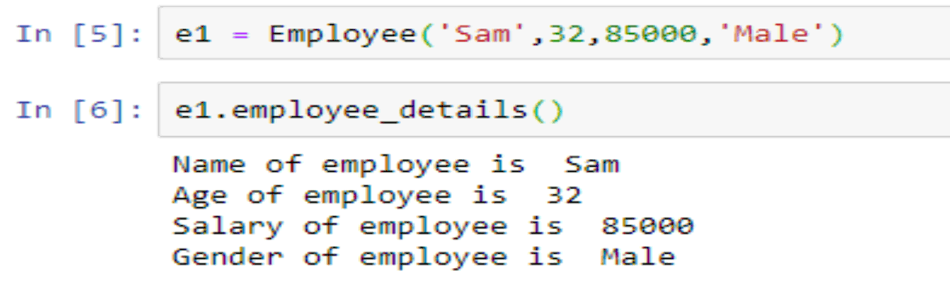
Instantiating Object
Instantiating the ‘e1’ object
Invoking the ‘employee_details’ method

Slide 13




Inheritance in Python
With inheritance one class can derive the properties of another class
Man inheriting features from his father

Slide 14

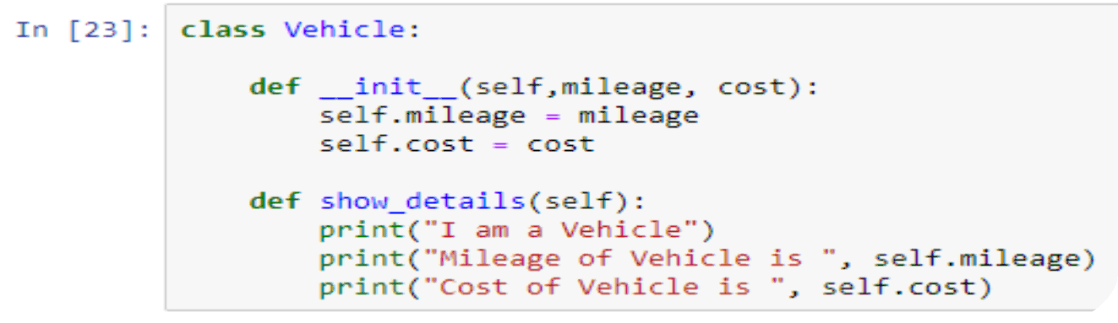

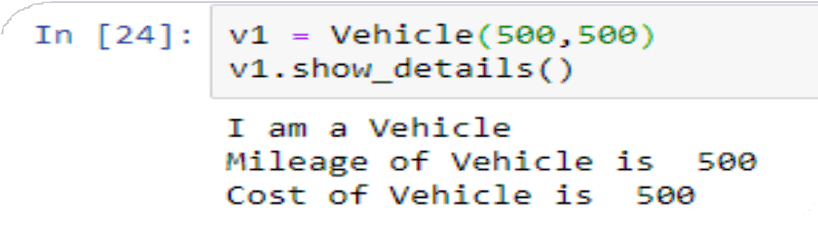
Inheritance Example
Creating the base class
Instantiating the object for base class

Slide 15

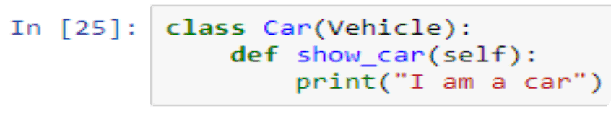

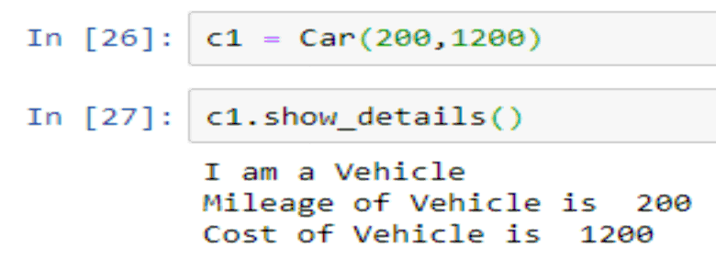

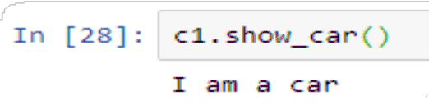
Inheritance Example
Creating the child class
Instantiating the object for child class
Invoking the child class method

Slide 16

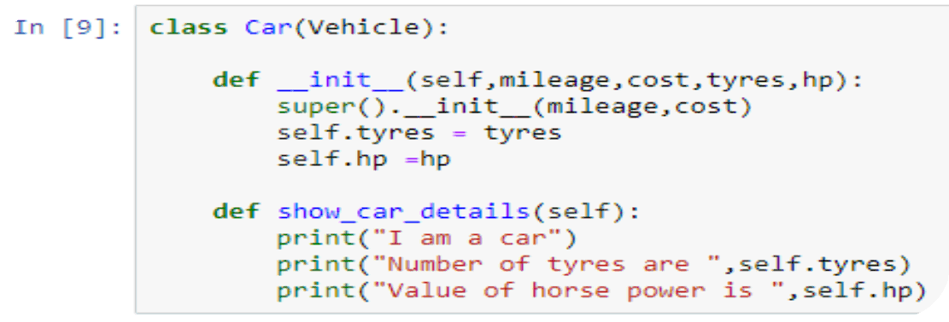

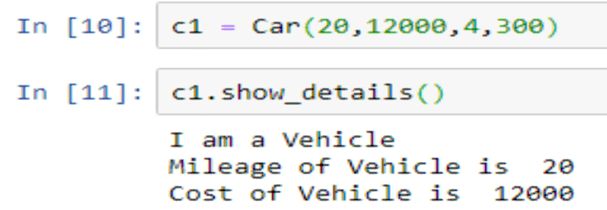

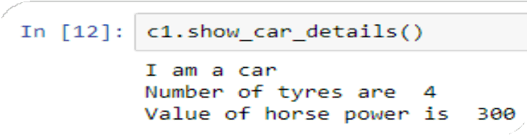
Over-riding init method
Over-riding init method
Invoking show_details() method from parent class
Invoking show_car_details() method from child class

Slide 17


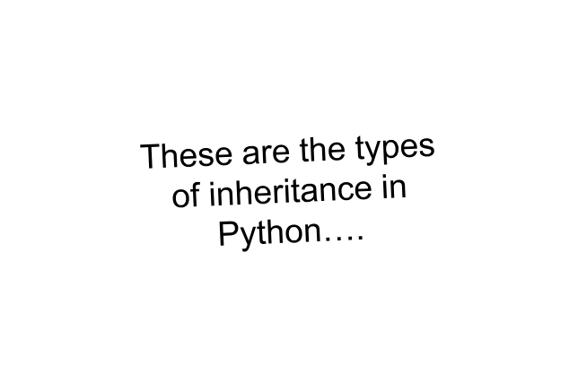


Types of Inheritance
Single Inheritance
Multiple Inheritance
Multi-level Inheritance
Hybrid Inheritance

Slide 18

Multiple Inheritance
In multiple inheritance, the child inherits from more than 1 parent class
Parent 1
Parent 2
Child

Slide 19


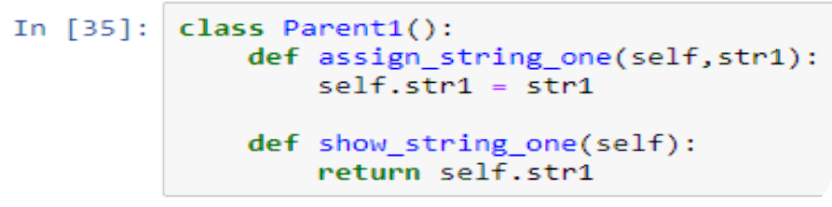
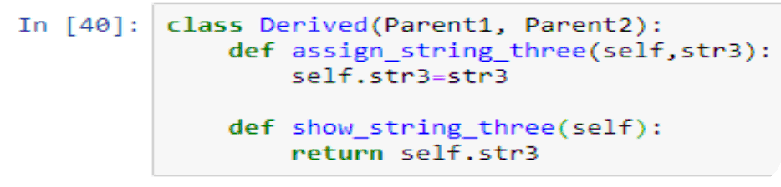

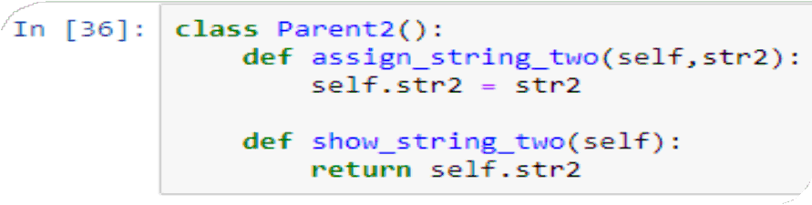
Multiple Inheritance in Python
Parent Class One
Child Class
Parent Class Two

Slide 20

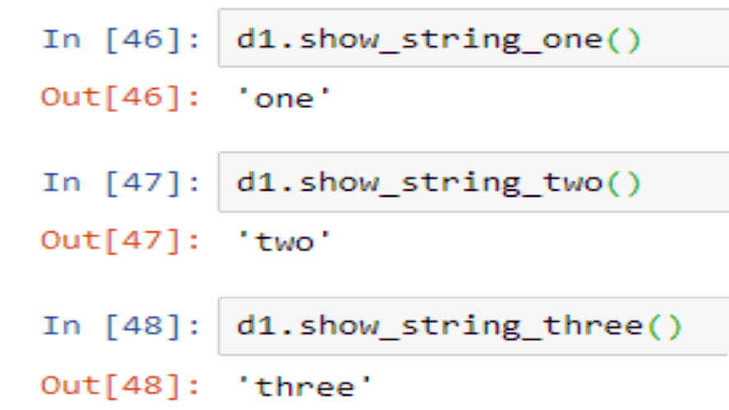

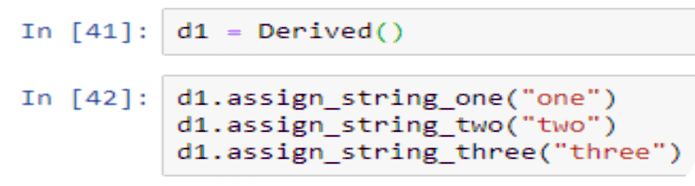
Multiple Inheritance in Python
Invoking methods
Instantiating object of child class

Slide 21
Multi-Level Inheritance
In multi-level Inheritance, we have Parent, child, grand-child relationship
Parent
Child
Grand-Child

Slide 22


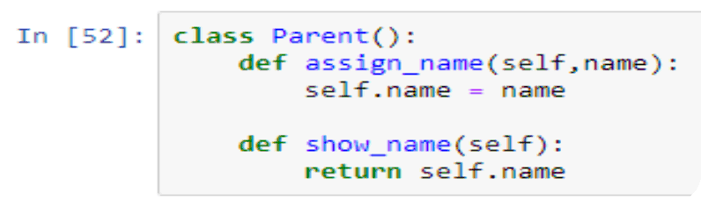
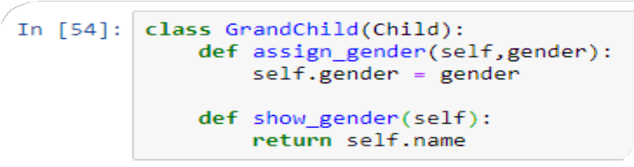

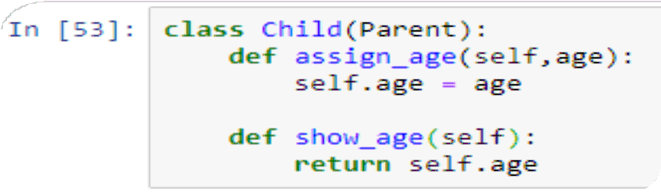
Multi-Level Inheritance in Python
Parent Class
Grand-Child Class
Child Class

Slide 23

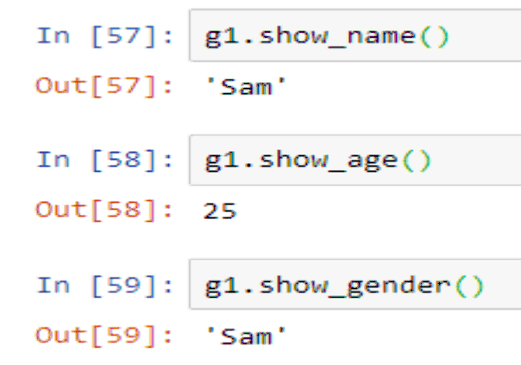

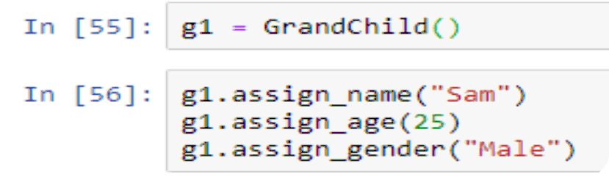
Multi-Level Inheritance in Python
Invoking class methods
Instantiating object of GrandChild class

Slide 24
Definitions :
Abstraction is the property by virtue of which only the essential details are displayed to the user.
Encapsulation is a process of binding data members and member functions into a single unit. Encapsulation hides the state of a structured data object inside a class, preventing unauthorized access to an unauthorized person.
Polymorphism is a Greek word that means many shaped. Polymorphism is the ability of a message to be displayed in more than one form.

